Slide 1
Methods of Proof
Session 5-6
Course : MATH6182 – Discrete Mathematics
Effective Period : September 2021

Slide 2

These slides have been adapted from :
Susanna S.Epp, “ Discrete Mathematics with Applications”, 5th edition,2020, Cengage, Boston, USA, ISBN 9781337694193
Chapter 4
Acknowledgement

Slide 3

Learning Objectives
On successful completion of this course, students will be able to:
LO2:
Solve problems of number theory, methods of proof and counting problems.

Slide 4
Sub Topics
1
Direct Proof
2
Indirect proof
3
Counter Example
  Mathematical Induction
3

Slide 5
Introduction
A theorem is a mathematical statement that is true and can be (and has beeb) verified as trus.
A definition is an exact, unambiguous explanation of the meaning of a mathematical word or phrase.
A proof is a valid argument that establishes the truth of a mathematical statement.
A proof can use the hypotheses of the theorem, if any, axioms assumed to be true, and previously proven theorems. Using these ingredients and rules of inference, the final step of the proof establishes the truth of the statement being proved.
Informal proofs can often explain to humans why theorems are true, while computers are perfectly happy producing formal proofs using automated reasoning systems.

Slide 6

Direct Proofs

Slide 7
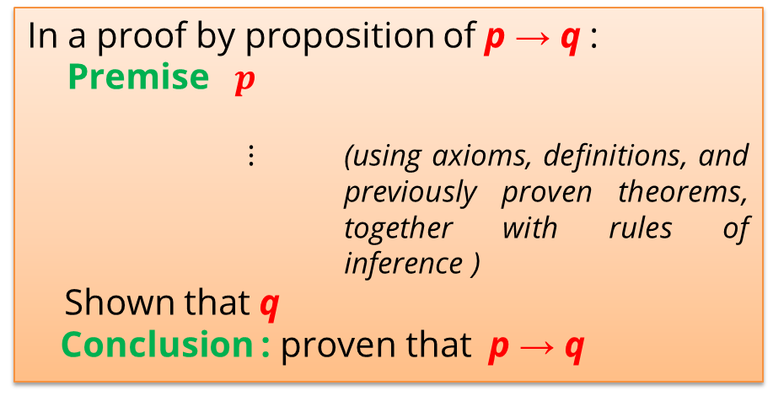
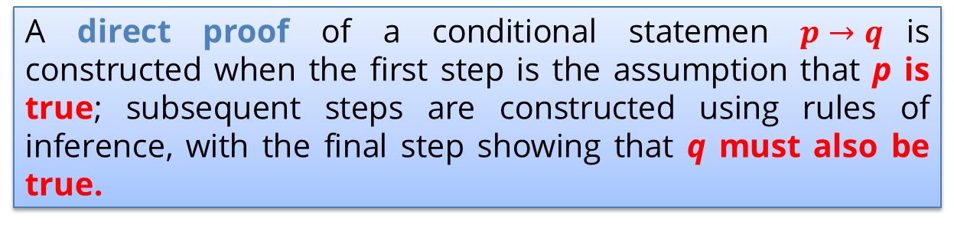
Direct Proofs
A direct proof of a conditional statemen $p→q$is constructed when the first step is the assumption that p is true; subsequent steps are constructed using rules of inference, with the final step showing that q must also be true.
In a proof by proposition of p → q :
Premise $p$
$⋮$ (using axioms, definitions, and previously proven theorems, together with rules of inference )
Shown that q
Conclusion : proven that p → q

Slide 8
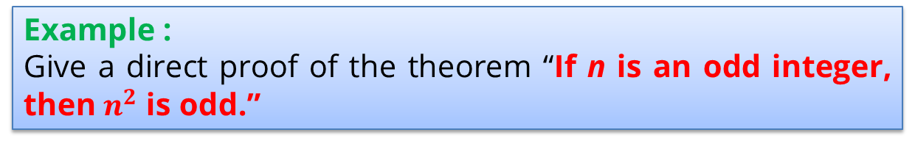
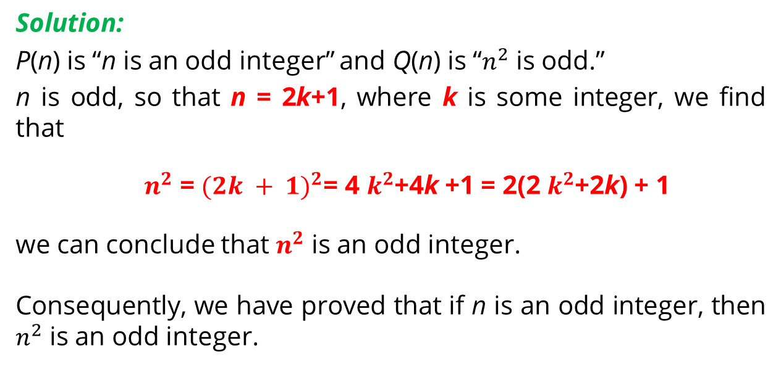
Direct Proofs
Example :
Give a direct proof of the theorem “If n is an odd integer, then $n^{2}$ is odd.”
Solution:
P(n) is “n is an odd integer” and Q(n) is “$n^{2}$ is odd.”
n is odd, so that n = 2k+1, where k is some integer, we find that
$n^{2}$ = ${(2k + 1)}^{2}$= 4 $k^{2}$+4k +1 = 2(2 $k^{2}$+2k) + 1
we can conclude that $n^{2}$ is an odd integer.
Consequently, we have proved that if n is an odd integer, then $n^{2}$ is an odd integer.

Slide 9
Direct Proofs
Definition
The real number r is rational if there exist integers p and q with q ≠ 0 such that r = p∕q. A real number that is not rational is called irrational.
Example :
Prove that the sum of two rational numbers is rational.
( For every real number r and every real number s, if r and s are rational numbers, then r + s is rational.)

Slide 10
Direct Proofs
Solution:
Suppose that r and s are rational numbers.
there are integers p and q, with q ≠ 0, such that r=p∕q, and integers t and u, with u ≠ 0, such that s=t∕u.
We find that
Because q ≠ 0 and u ≠ 0, it follows that qu ≠ 0.
Consequently, we have expressed
r + s = v/w, where v = pu + qt and w = qu, and w ≠ 0.
This means that r + s is rational.
We have proved that the sum of two rational numbers is rational.

Slide 11
Indirect Proofs

Slide 12
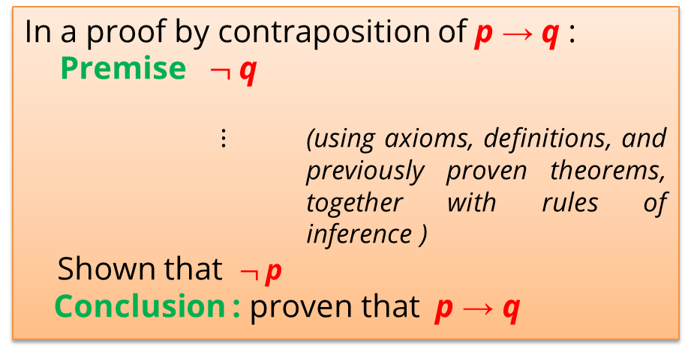
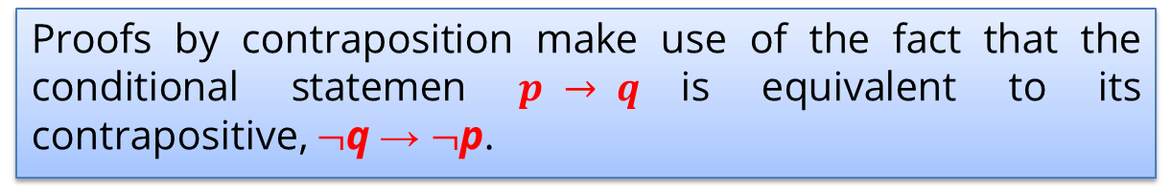
Proofs by Contraposition
Proofs by contraposition make use of the fact that the conditional statemen $p → q$is equivalent to its contrapositive, $¬$q → $¬$p.
In a proof by contraposition of p → q :
Premise $¬$q
$⋮$ (using axioms, definitions, and previously proven theorems, together with rules of inference )
Shown that $¬$p
Conclusion : proven that p → q

Slide 13
Proofs by Contraposition Example 1
Prove that if n is an integer and 3n + 2 is odd, then n is odd.
Solution:
Assume that the conclusion of the conditional statement
“If 3n + 2 is odd, then n is odd” is false;
assume that n is even.
n = 2k , for some integer k.
3n +2 = 3(2k) + 2 = 6k + 2 = 2(3k + 1).
So that 3n + 2 is even (because it is a multiple of 2), and therefore not odd.
We have proved the theorem “If 3n + 2 is odd, then n is odd.”

Slide 14
Proofs by Contraposition Example 2
Prove that if n = ab, where a and b are positive integers, then a ≤√n or b ≤√n.
Solution:
Assume that the conclusion of the conditional statement “If n = ab, where a and b are positive integers, then a ≤√n or b ≤√n” is false.
That is,we assume that the statement (a ≤√n) ∨ (b ≤√n) is false.
This implies that a >√n and b >√n.
We can multiply these inequalities together (using the fact that if 0 < s < t and 0 < u < v, then su < tv) to obtain ab >√n ⋅√n = n.
This shows that ab ≠ n, which contradicts the statement n = ab.
Because the negation of the conclusion of the conditional statement implies that the hypothesis is false, the original conditional statement is true.
We have proved that if n = ab, where a and b are positive integers, then a ≤√n or b ≤√n.

Slide 15
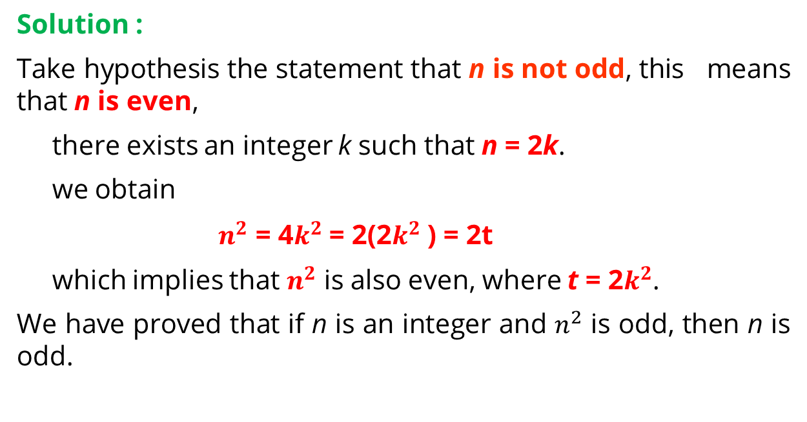
Proofs by Contraposition Example 3
Prove that if n is an integer and $n^{2}$ is odd, then n is odd.
Solution :
Take hypothesis the statement that n is not odd, this means that n is even,
there exists an integer k such that n = 2k.
we obtain
${ n}^{2}$ = 4$k^{2}$ = 2(2$k^{2}$ ) = 2t
which implies that $n^{2}$ is also even, where t = 2$k^{2}$.
We have proved that if n is an integer and $n^{2}$ is odd, then n is odd.

Slide 16
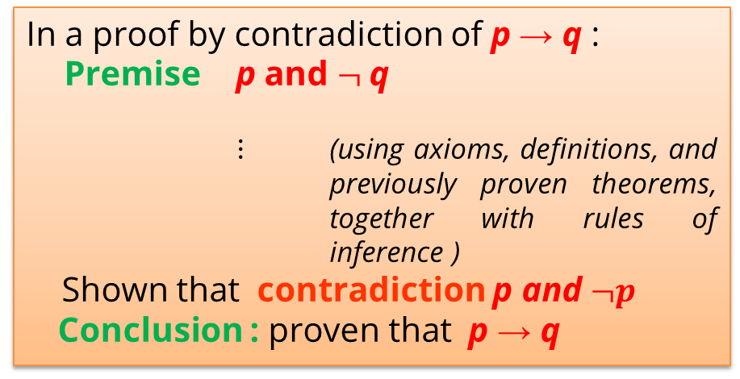
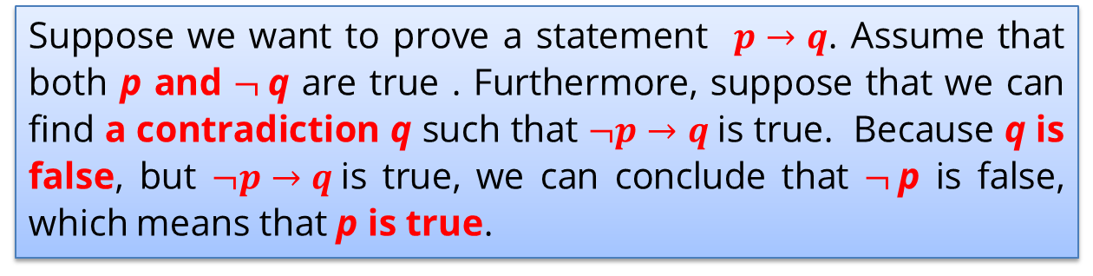
Proofs by Contradiction
Suppose we want to prove a statement $p→q$. Assume that both p and $¬$q are true . Furthermore, suppose that we can find a contradiction q such that $¬p→q$is true. Because q is false, but $¬p→q$is true, we can conclude that $¬$p is false, which means that p is true.
In a proof by contradiction of p → q :
Premise p and $¬$q
$⋮$ (using axioms, definitions, and previously proven theorems, together with rules of inference )
Shown that contradiction p and $¬p$
Conclusion : proven that p → q

Slide 17
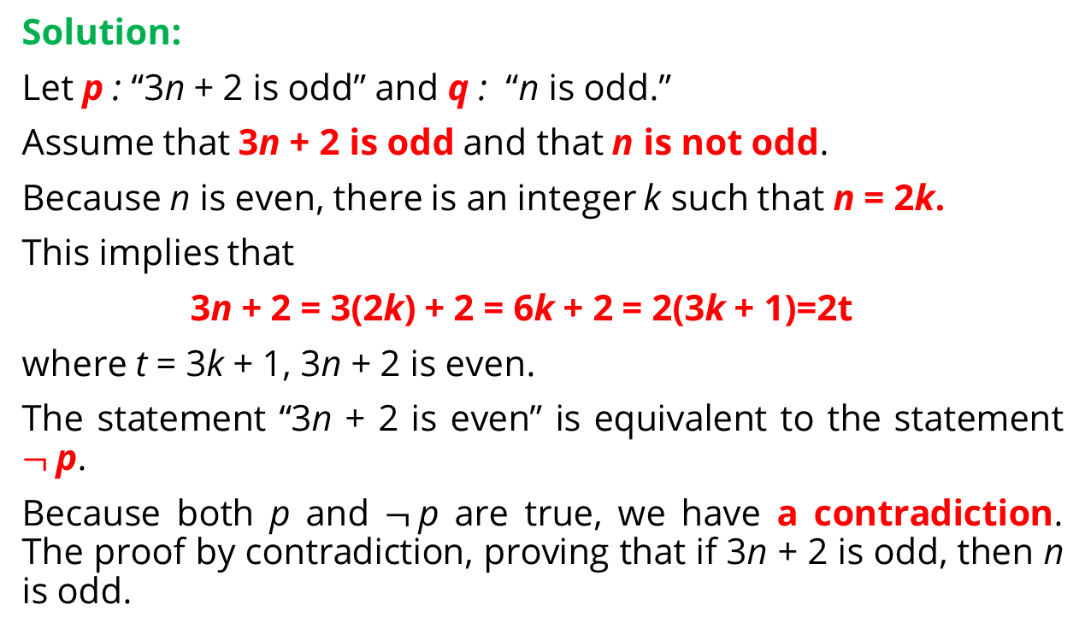
Proofs by Contradiction
Example 1
Give a proof by contradiction of the theorem “If 3n + 2 is odd, then n is odd.”
Solution:
Let p : “3n + 2 is odd” and q : “n is odd.”
Assume that 3n + 2 is odd and that n is not odd.
Because n is even, there is an integer k such that n = 2k.
This implies that
3n + 2 = 3(2k) + 2 = 6k + 2 = 2(3k + 1)=2t
where t = 3k + 1, 3n + 2 is even.
The statement “3n + 2 is even” is equivalent to the statement $¬$p.
Because both p and $¬$p are true, we have a contradiction. The proof by contradiction, proving that if 3n + 2 is odd, then n is odd.

Slide 18


Proofs by Contradiction
Example 2
The sum of any rational number and any irrational number is irrational.
Proof :
Suppose there is a rational number r and an irrational number s such that r + s is rational.
By definition of rational, r=a/b, and s= c/d. for some integers a, b, c, and d with b 0, d 0. By substitution,
Now bc − ad and bd are both integers and bd 0. Hence s is a quotient of the two integers bc − ad and bd with bd 0.
Thus, by definition of rational, s is rational, which contradicts the supposition that s is irrational.
[Hence the supposition is false and the theorem is true.]

Slide 19
Counterexamples

Slide 20
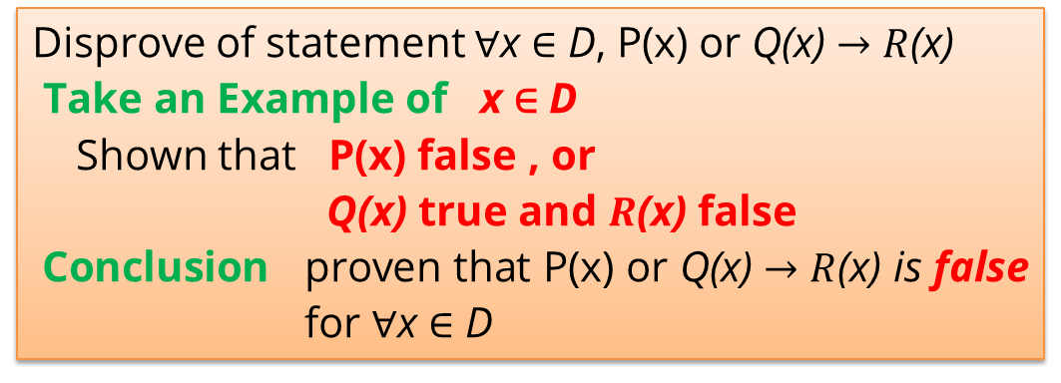
Counterexample
Statement of the form ∀xP(x) is false, we need only find a counterexample, that is, an example x for which P(x) is false.
To disprove a statement of the form “∀x ∈ D, if P(x) then Q(x),” find a value of x in D (called a counterexample) for which the hypothesis P(x) is true and the conclusion Q(x) is false.
Disprove of statement ∀x ∈ D, P(x) or Q(x) $→R$(x)
Take an Example of x ∈ D
Shown that P(x) false , or
Q(x) true and $R$(x) false
Conclusion proven that P(x) or Q(x) $→R$(x) is false for ∀x ∈ D

Slide 21
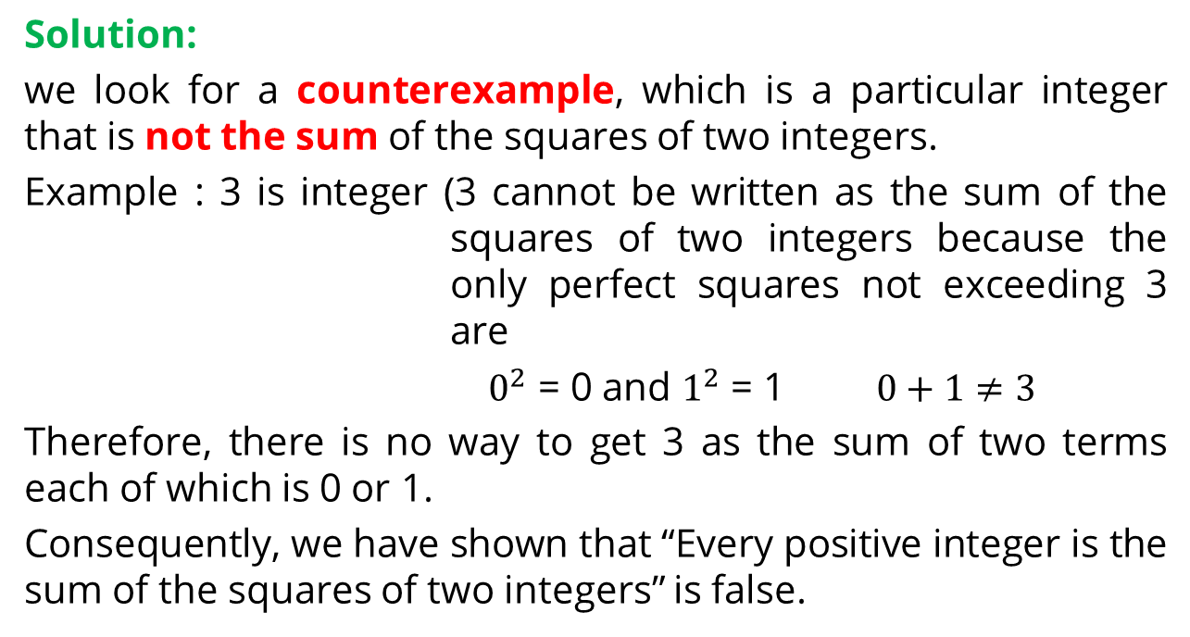
Counterexample
Example :
Show that the statement “Every positive integer is the sum of the squares of two integers” is false.
Solution:
we look for a counterexample, which is a particular integer that is not the sum of the squares of two integers.
Example : 3 is integer (3 cannot be written as the sum of the squares of two integers because the only perfect squares not exceeding 3 are
${ 0}^{2}$ = 0 and $1^{2}$ = 1 $0+1≠3$
Therefore, there is no way to get 3 as the sum of two terms each of which is 0 or 1.
Consequently, we have shown that “Every positive integer is the sum of the squares of two integers” is false.

Slide 22
Mathematical Induction

Slide 23
Infinite ladder
Illustration

Slide 24
Introduction
Suppose that we have an infinite ladder. we want to know whether we can reach every step on this ladder. We know two things:
1. We can reach the first rung of the ladder.
2. If we can reach a particular rung of the ladder, then we can reach the next rung.
By (1), we know that we can reach the first rung of the ladder. Moreover, because we can reach the first rung,
By (2), we can also reach the second rung; it is the next rung after the first rung. Applying (2) again, after 100 rung,
Uses of (2), we know that we can reach the 101st rung.

Slide 25
Mathematical Induction
A proof by mathematical induction has two parts, a basis step, where we show that P(1) is true, and an inductive step, where we show that for all positive integers k, if P(k) is true, then P(k + 1) is true.
Principle of mathematical induction :
To prove that P(n) is true for all positive integers n, where P(n) is a propositional function, we complete two steps:
1. BASIS STEP : We verify that P(1) is true.
2. INDUCTIVE STEP : Assume P(k) is true, We show that the conditional statement P(k) → P(k + 1) is true for all positive integers k.

Slide 26
Mathematical Induction
Example 1:
Show that if n is a positive integer, then
Solution :
Let P(n) be the proposition that the sum of the first n positive integers,
1 + 2 +⋯n =
BASIS STEP : P(1) is true, because
INDUCTIVE STEP : For the inductive hypothesis we assume that P(k) holds for an arbitrary positive integer k. That is, we assume that

Slide 27
Mathematical Induction
Under this assumption, it must be shown that P(k + 1) is true, namely, that
is also true.
When we add k + 1 to both sides of the equation in P(k), we obtain
This last equation shows that P(k + 1) is true under the assumption that P(k) is true

Slide 28
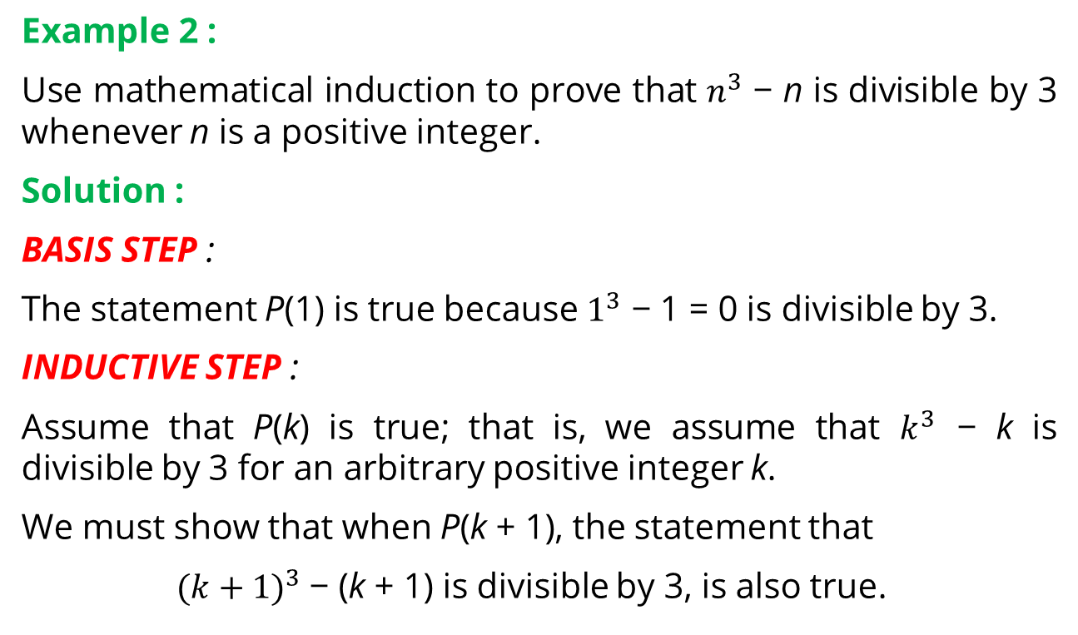
Mathematical Induction
Example 2 :
Use mathematical induction to prove that $n^{3}$ − n is divisible by 3 whenever n is a positive integer.
Solution :
BASIS STEP :
The statement P(1) is true because $1^{3}$ − 1 = 0 is divisible by 3.
INDUCTIVE STEP :
Assume that P(k) is true; that is, we assume that $k^{3}$ − k is divisible by 3 for an arbitrary positive integer k.
We must show that when P(k + 1), the statement that
${(k+1)}^{3}$− (k + 1) is divisible by 3, is also true.

Slide 29
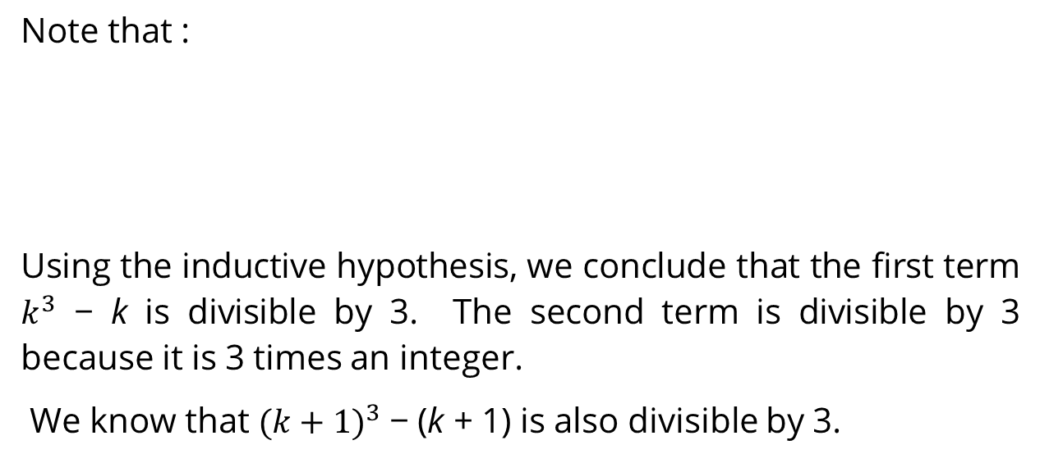
Mathematical Induction
Note that :
Using the inductive hypothesis, we conclude that the first term $k^{3}$ − k is divisible by 3. The second term is divisible by 3 because it is 3 times an integer.
We know that ${(k+1)}^{3}$− (k + 1) is also divisible by 3.

Slide 30
References
Susanna S.Epp, “ Discrete Mathematics with Applications”, 5th edition,2020, Cengage, Boston, USA, ISBN 9781337694193
Kenneth H. Rosen, “ Discrete Mathematics and its Applications”, 8th edition,2019, McGraw-Hill Education, New York, ISBN 978-1-259-67651-2

Slide 31
THANK YOU

